Slide 1
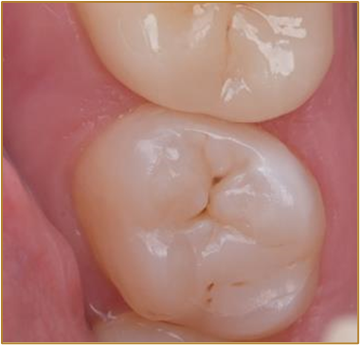
GC
ACADEMIC EXCELLENCE CONTEST
2024
Take the challenge and match your restorative skills with the best dental students all over Europe, Middle East and North Africa.
You may have heard about GC’s G-aenial Universal Injectable, a truly universal restorative composite with unique injectable consistency. Stepping away from the traditional frame of packable and flowable composites, G-aenial Universal Injectable opens a new world of possibilities. We invite you to discover two of them: cusp-by-cusp posterior restorations combined with everX Flow for undergraduate students and Injection Molding Technique for postgraduate students.
Taking part in our contest is easy! Take pictures of your clinical case with G-aenial Universal Injectable, post them on Facebook https://www.facebook.com/groups/gcacademicexcellencecontest
and/or Instagram https://www.instagram.com/gc.academic.excellence.contest/ and be amongst the winners on university, national or European level!
When amongst the winners on national level, you can showcase your work in the European final of the GC Academic Excellence Contest and attend the Master Course at the GC Europe Campus in Leuven, Belgium.
Each case will be evaluated by an independent jury on originality, complexity, quality and presentation. There’s also a popularity contest based on Facebook and Instagram likes and shares.
For more information or to register, please contact:
Join the next GC Academic Excellence Contest and win an unforgettable trip and a unique training!
Name:
Email:
Phone:

